Slide 1
The TreeMap
The TreeMap

Slide 2
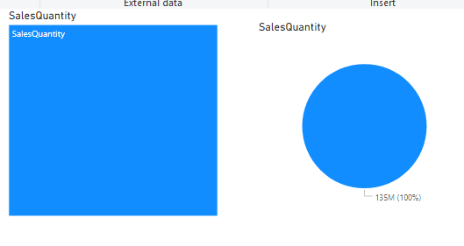
The TreeMap
Add the TreeMap and Pie visualization to the scene level and configure both visualizations to show the OrderQuantity from FactInternetSales

Slide 3
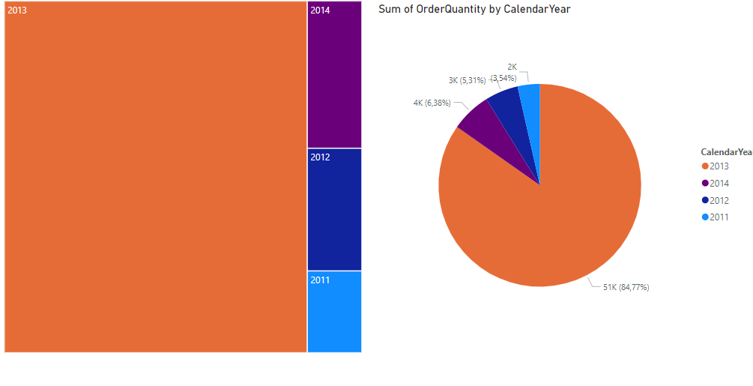
The TreeMap
Note that to configure TreeMap there is a difference compared to Pie in that the Legend parameter becomes Category in the case of TreeMap

Slide 4
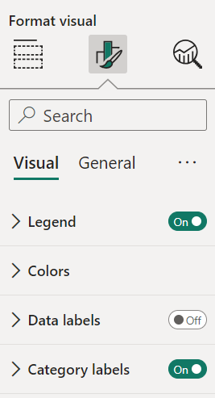
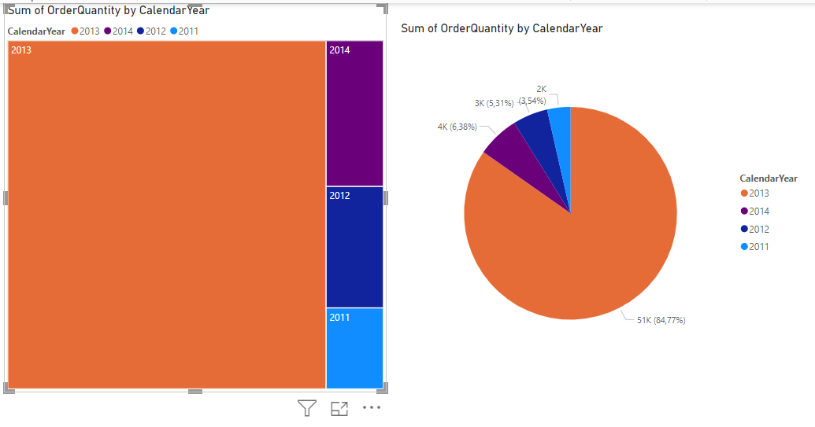
The TreeMap
Add a legend at the TreeMap level by selecting the Format section then activating Legend

Slide 5
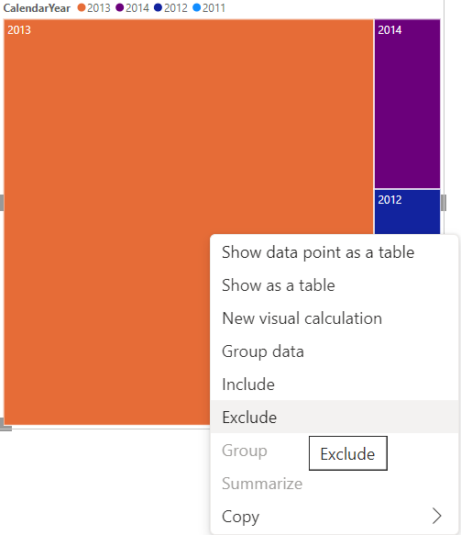
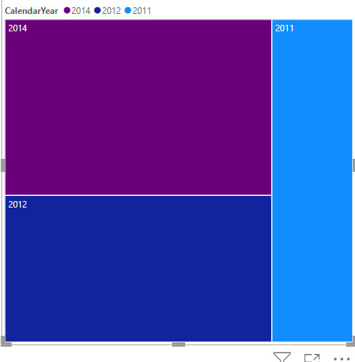
The TreeMap
It is possible to exclude or include sectors in both cases of visualizations, by right clicking mouse and selecting include or exclude

Slide 6
Thank you
Thank you

